Slide 1
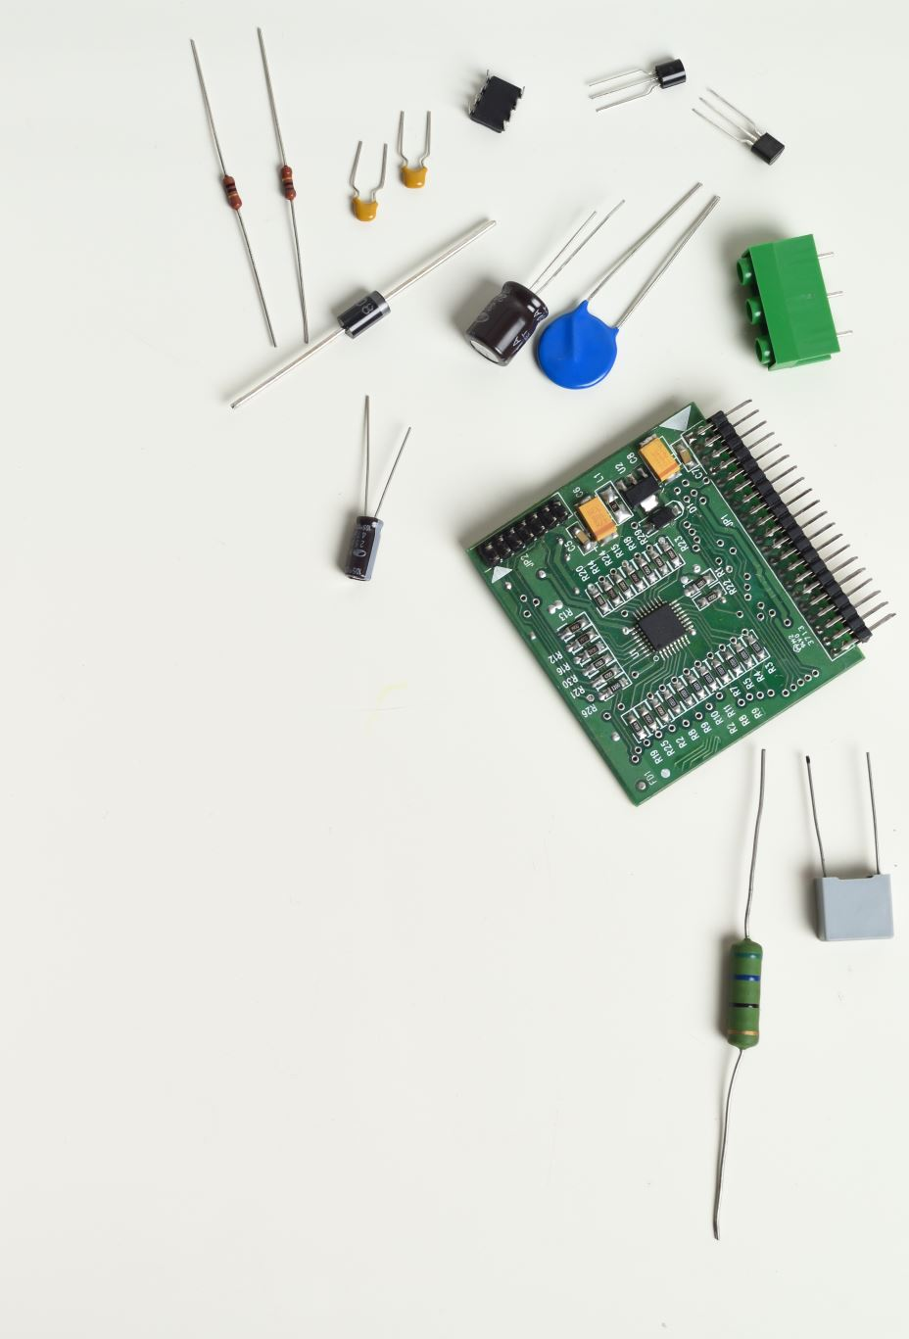
Farmer’s Techie - IOTC & ML
Sumanth Kumar Sivadi
Hema Likhitha Adapa
Kaushik Ram Koteshwar Venna
Sri Vasavi Peravarapu
Varsha Pravallika Valavala

Slide 2
Introduction
The current trending technologies are Cloud, Machine Learning, Internet of Things.
There are many things we can solve using these current technologies. We thought of a way to solve of the problem that we mostly see using these technologies.
Even in this technological world there are still few things which are following the traditional methods, one those sectors is Agriculture sector. There is lot of upgrade in the agriculture techniques but still we can implement many more things.

Slide 3
Motivation
Water is main resource for any type of crop. Crop with the right amount of water gives good yield. Supplying correct amount of water to crop is crucial. Supplying proper water can’t be possible all the time by humans.
Smart irrigation is a one-time investment and further reduces the cost.
Over irrigation can lead to problems such as erosion, nutrient leaching and decreases soil fertility.
Use of technologies provides farmer with access to detailed data about their fields.

Slide 4
Problem Definition
In many cases, Farmer’s themselves should get into the field to perform irrigation but there are some situations where they themselves can’t do the things manually.
Such as checking soil moisture level, temperature, humidity.
This process is time consuming and there can be many human errors.
Checking these levels and maintaining the level at regular interval of times cannot be possible all the time.
There are some techniques where irrigation starts as soon as the soil moisture drops but, in that case when there is sudden increment in moisture level through external factor then crop maybe damaged.

Slide 5
Proposed Solution
Our Proposed solution to develop the automated irrigation system. Farmer without actually getting into the farm and can access the information through mobile device.
We would like to implement this using Machine Learning and Internet of Things(IOT).
We calculate the moisture in the soil in timely basis
If the moisture level is less than the cutoff for certain time we take the automatic necessary irrigation action. We do this through the Formal Verification methods.
Every time there is a requirement of irrigation it is notified to farmer by storing the data in the cloud.

Slide 6
DEMONSTRATION Using TensorFlow for Crop Disease Prediction
TensorFlow is an open-source machine learning framework developed by Google.
Here's how TensorFlow is used:
Data Collection and Preprocessing: Initially, a dataset containing images of healthy crops and crops affected by various diseases is collected. This dataset needs to be labeled with the corresponding disease for each image.
Model Selection or Customization: Researchers or developers may design custom models tailored to the crop disease prediction task using TensorFlow's high-level APIs like Keras.

Slide 7
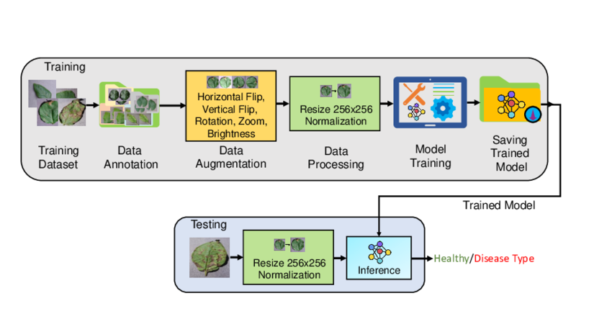
Training: During training, the model learns to extract relevant features from the images and make predictions about whether a crop is healthy or diseased and, if diseased, which disease it has.
Validation and Evaluation: After training, the model's performance is evaluated using a separate validation dataset to assess its accuracy, precision, recall, and other performance metrics.
Deployment: Once the model achieves satisfactory performance, it can be deployed in production environments for crop disease prediction. Deployment options include integrating the model into web applications, mobile apps, or embedded systems used in agricultural machinery or drones.

Slide 8
Using TensorFlow LITE for Crop Disease Prediction
TensorFlow Lite is a popular framework for deploying machine learning models on mobile and edge devices, making it suitable for applications like crop disease prediction.
Here's how TensorFlow Lite is used:
Model Training: Initially, a machine learning model is trained using TensorFlow. This model is typically trained on a dataset containing images of healthy crops as well as crops affected by various diseases.

Slide 9
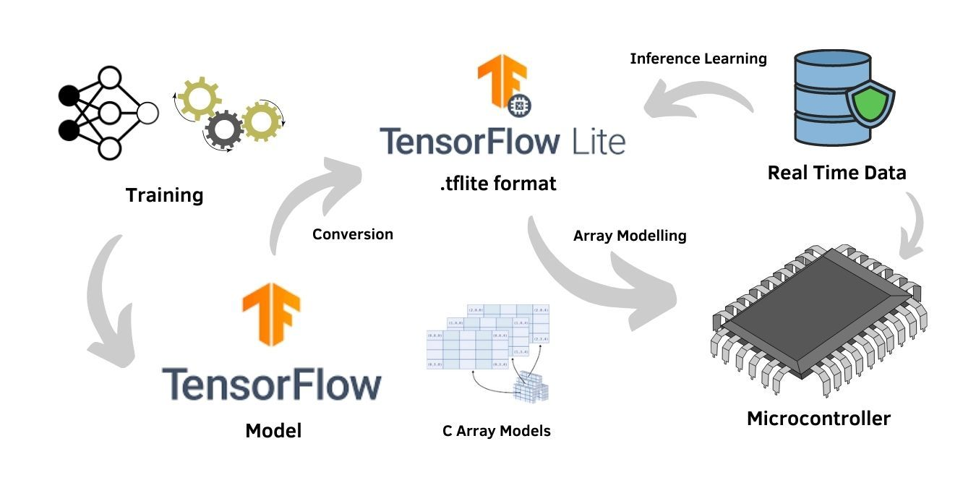
Model Conversion: TensorFlow provides tools to convert a trained model to TensorFlow Lite format.
Integration into Mobile App: The TensorFlow Lite model is then integrated into a mobile application designed for crop disease prediction.
Inference: When a user captures an image of a crop, the image is passed through the TensorFlow Lite model for inference. The model processes the image and makes predictions about whether the crop is healthy or diseased, as well as potentially identifying the specific disease if applicable.

Slide 10
ML Model : CNN
Convolutional Neural Networks (CNNs) are a powerful class of deep learning models commonly used for image recognition tasks, including crop disease prediction.
Data Collection: The first step is to collect a large dataset of images containing healthy crops as well as crops affected by various diseases.
Data Preprocessing: The collected images are preprocessed to ensure consistency and improve the model's performance. Preprocessing steps may include resizing images to a uniform size, normalizing pixel values to a standard range, and augmenting the dataset with transformations such as rotation, flipping, and cropping to increase its diversity.
Model Architecture Design: A CNN model architecture is designed to learn meaningful features from the input images and make predictions about the presence and type of crop diseases.

Slide 11
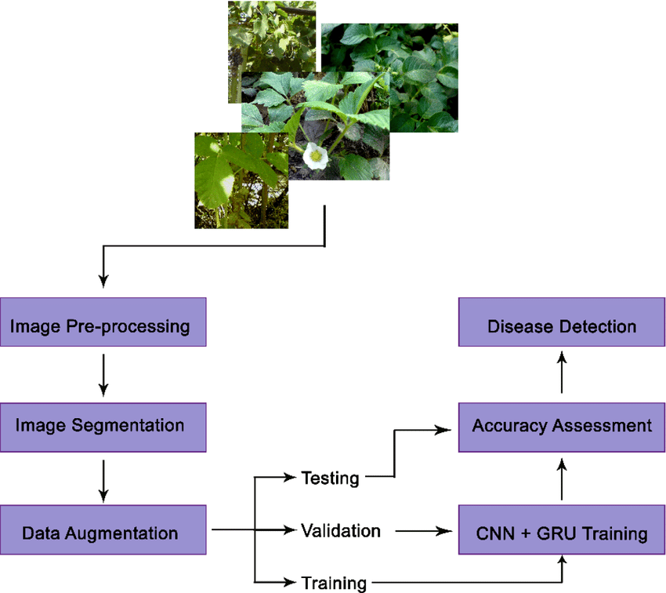
Training The CNN model is trained on the preprocessed dataset using a supervised learning approach. During training, the model learns to identify patterns and features indicative of different crop diseases by adjusting the weights of its neurons through backpropagation and gradient descent optimization.
Validation: To assess the performance of the trained CNN model, it is evaluated on a separate validation dataset that was not used during training. Performance metrics such as accuracy, precision, recall, and F1-score are calculated to measure the model's ability to correctly classify images of healthy crops and crops with diseases.
Deployment: Once the CNN model achieves satisfactory performance on the validation dataset, it can be deployed in production environments for real-time crop disease prediction. The model can be integrated into web applications, mobile apps, or embedded systems used in agricultural machinery or drones.

Slide 12
IDE’s Used
Arduino :
The Arduino IDE is straightforward and easy to use, especially for beginners. It provides a simple interface for writing, compiling, and uploading code to Arduino boards.
The IDE comes with a vast collection of libraries that make it easy to interface with various sensors, actuators, and communication modules commonly used in IoT projects.
VS Code :
VS Code offers extensive customization options through its vast array of extensions. Developers can install extensions for Arduino development, IoT, Git integration, debugging, and more, tailoring the environment to their specific needs.
VS Code seamlessly integrates with version control systems like Git, allowing developers to manage their IoT projects more efficiently.

Slide 13
Future Plan
In this semester and the following semester, we would like to implement, monitoring soil moisture level along with the temperature and humidity level.
In the following semester, we are going to implement Formal verification using ML methods.
We would also like to implement the Plant disease prediction using integrated camera.

Slide 14
Conclusion
In this technological world, everything has its own way of solving problems.
This IoT based smart irrigation project allows farmers to significantly upgrade agricultural practices.
Proper water management can lead to healthier crops and potentially higher yields.
It allows to maintain the proper soil moisture level and starts the irrigation with notifying the farmer regarding the irrigation and report.
This helps in improving the soil fertility, reduce cost to the farmers and for good yield.

Slide 15
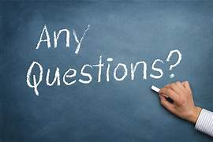

Slide 16


